Slide 1



Meetings to Actions Copilot
Presented by Nayeem Badshah
Notes:
Good morning/afternoon everyone. My name is Nayeem Badshah, and today I’ll be presenting Meetings to Actions Copilot — an execution-focused AI assistant designed to close the gap between discussion and delivery. Across EXL, we spend countless hours in meetings, but a significant portion of commitments never translate into actions. This solution aims to solve that problem in a simple, automated, and scalable way.

Slide 2

The Problem: Actions Lost
01
02
03
04
Inconsistent action capture leads to missed opportunities for teams.
Actions scattered across emails and chats create confusion and delays.
Lack of ownership results in unmonitored tasks and accountability gaps.
Leadership blind spots hinder effective decision-making and strategic alignment.
Notes:
One of the biggest operational gaps we face is that meeting commitments get lost. Actions are captured inconsistently, often scattered across notes, chats, or emails. Owners and due dates are unclear, which leads to follow-ups being missed and avoidable SLA and client risks. Leaders also lack visibility into who committed to what, and whether those commitments were fulfilled. This is not a tool problem — this is an execution discipline problem. And that’s what we fix

Slide 3
Value Proposition
Automated Capture
Auto-capture functionality ensures that critical actions are recorded in real-time, preventing any omissions during discussions or meetings.
Transforming Meetings into Actionable Deliverables Efficiently
Clear Ownership
Assigning clear owners to each action item boosts accountability and ensures that tasks are monitored until completion by responsible individuals.
Faster Execution
The streamlined process facilitates quicker task execution, enabling teams to operate at a higher efficiency and significantly reduce project timelines.
Notes:
The value is simple: every meeting ends with clear owners, clear tasks, and clear due dates—automatically. This improves execution speed, reduces leakage, and gives leadership transparent visibility into commitments.

Slide 4

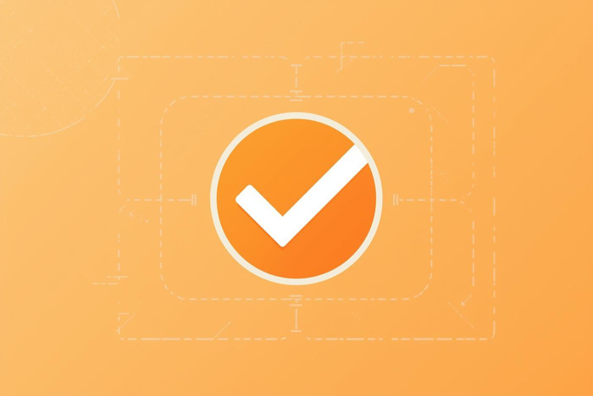
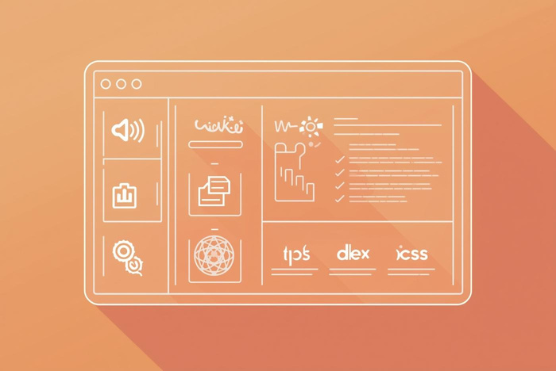
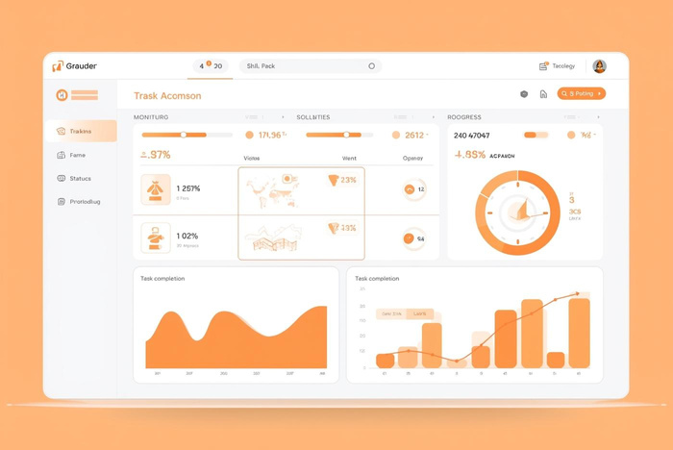

Solution Overview
Capture
Create
Effortlessly document important actions during meetings.
Transform captured actions into actual tasks seamlessly.
Confirm
Track
Verify each action taken for clarity and accountability.
Monitor progress and ensure timely execution of tasks.
Notes:
Our proposed solution is the Meetings to Actions Copilot — a Teams-native assistant that automatically converts discussions into structured, trackable actions. It works in four simple steps:
Capture actions from transcripts, chats, or manual tagging.
Confirm them with a quick 30-second review at the end of the meeting.
Create tasks automatically in Planner, Jira, or ServiceNow.
Track progress through nudges, dashboards, and a ‘My Actions’ view for users. This ensures every meeting ends with clarity, ownership, and accountability.

Slide 5



User Journey Overview
Mark Actions
Review at Wrap-Up
Auto-Create Tasks
Quickly mark discussion points as actionable items during meetings.
Summarize and confirm action items to ensure clarity and ownership.
Transform marked actions into tasks automatically for efficient tracking.
Notes:
The user journey is intentionally simple. During the meeting, participants can mark any statement as an action. At the meeting wrap-up, the Copilot automatically posts a draft action list for review. Once the team confirms, tasks are created instantly in the system of record. After the meeting, users receive nudges and visibility through dashboards. This creates a clean loop from discussion to commitment to closure.

Slide 6
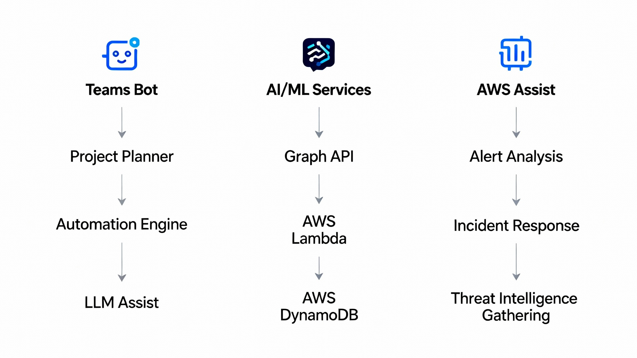
Architecture Overview
Integrating Teams and AI Solutions
This architecture leverages existing EXL technologies, ensuring a seamless integration of Teams Bot, Graph API, and cloud services like AWS Lambda and DynamoDB for efficient automation and task management.

Slide 7

Innovation in Action
Meeting-to-Action Automation
Our first-of-its-kind solution enhances productivity without requiring new tools.
Notes:
This solution is innovative for several reasons. First, it automates something that currently takes teams a lot of manual effort. Second, it combines AI extraction with human-in-the-loop validation, ensuring high accuracy and trust. Third, it integrates with the tools we already use — Teams, Planner, Jira, ServiceNow — meaning zero change management. And finally, it creates a standard governance rhythm across EXL, strengthening our delivery discipline.

Slide 8
Feasibility & POC
Setup
MVP
Pilot
Improve
Configure current tools and establish the project framework.
Develop a minimal viable product to showcase key functionalities.
Conduct testing and gather feedback to refine the solution.
Implement enhancements based on pilot insights and prepare for scaling.
Notes:
To ensure feasibility, we’re proposing a structured and low-risk POC. It consists of four phases:
Setup — configuring current EXL tools and establishing the project framework. MVP — building the minimal viable version focused on end-of-meeting action capture. Pilot — testing with select users, collecting real-world data and feedback. Improve — implementing enhancements based on insights and preparing for scale.
Each step is intentionally lightweight and uses existing EXL technology.

Slide 9


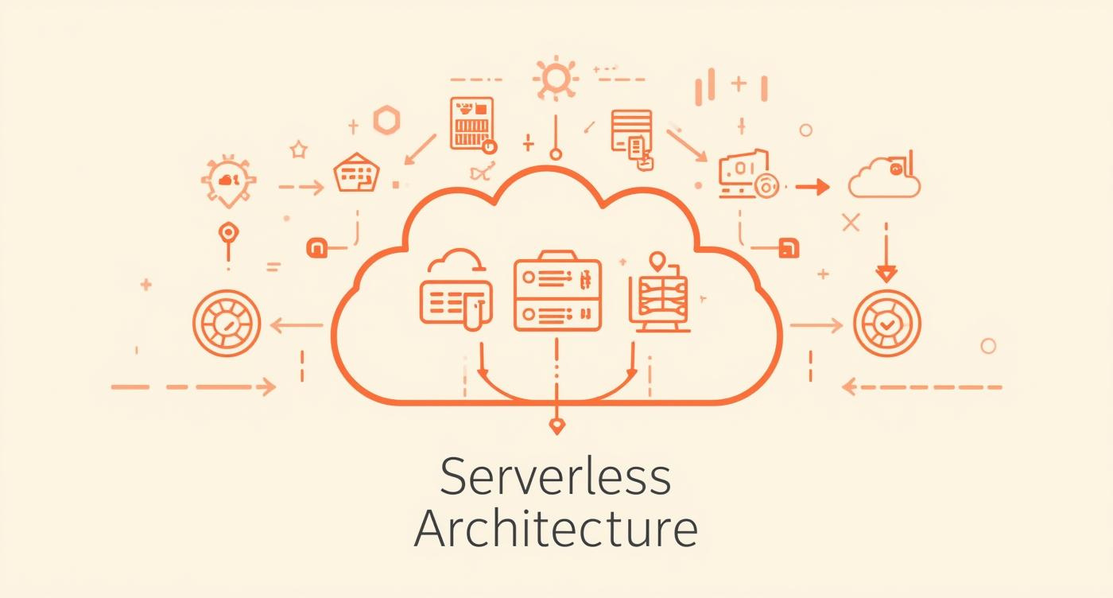
Feasibility Overview
6-8 week POC
Serverless, low cost
The proof of concept will be completed within six to eight weeks.
This approach ensures cost-effective solutions with minimal infrastructure overhead.
Notes:
The solution is highly feasible for several reasons: It uses Microsoft Teams, Graph API, and our existing cloud stack like Azure or AWS. The architecture is serverless and low cost. We only store action metadata — transcripts remain ephemeral — ensuring compliance with internal data policies. And because this fits naturally into the meeting workflow, the adoption barrier is extremely low

Slide 10
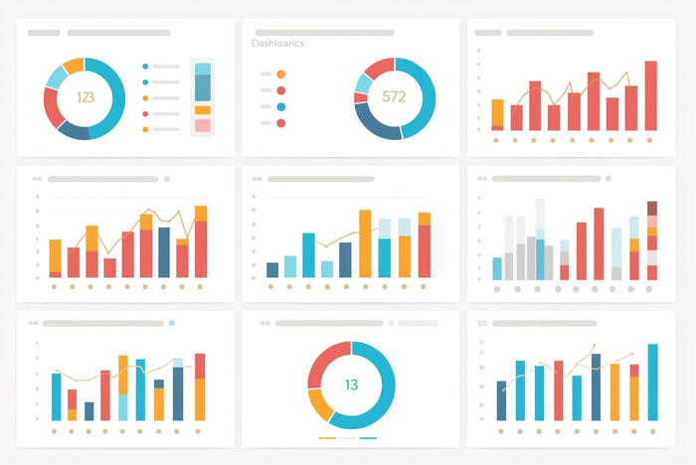



KPIs for Success
Meeting Actions
Closure Speed
70% of meetings are expected to produce actionable outcomes.
Aiming for 20% faster closure on tasks and projects.
Automated Actions
Engagement Rate
Targeting 60% of actions to be automated seamlessly.
Aiming for a weekly active user rate of at least 60%.
Notes:
We’ve defined clear KPIs to measure POC success within 6–8 weeks. We aim for at least 70% of meetings generating an action list. At least 60% of actions should be auto-created in the system of record. We target a 20% improvement in on-time action closure. And we want at least 60% weekly active usage within the pilot group. These metrics directly reflect execution speed, accountability, and adoption.

Slide 11


Market Disruption Potential
Standardized Governance
Scalable Solutions
Streamlining meeting processes enhances efficiency and accountability across teams.
Adaptable framework allows for seamless integration across diverse client needs.
Notes:
This has strong potential to become a standard across EXL. It introduces a consistent, predictable way to capture and track commitments. It reduces the overhead of note-taking and manual action tracking. And because it’s built on top of Teams, it’s scalable to thousands of users with minimal cost. In future stages, this can even be extended to client-facing engagements

Slide 12
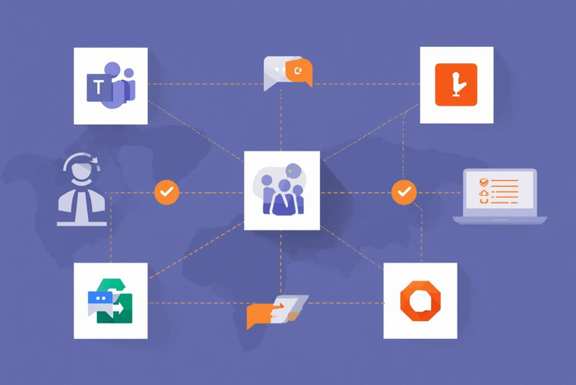


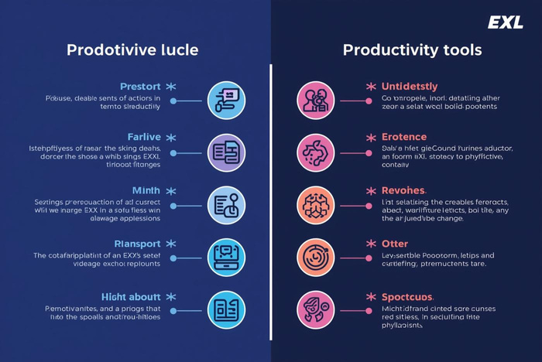
Competitive Advantage
Deep Integration
Enterprise Compliance
Enhanced productivity through tight Microsoft Teams integration.
Meets stringent data loss prevention standards effortlessly.
Seamless Workflow
Superior Performance
Users experience smooth transitions with no additional tools.
Outperforms alternatives with unique EXL features and benefits.
Notes:
While tools like Otter, Fireflies, or Notion can capture notes, they do not integrate with enterprise systems like Planner, Jira, or ServiceNow. They also don’t provide end-to-end governance or follow-through. Our Copilot is purpose-built for execution, built on EXL’s environment, aligned with DLP policies, and focuses on closing the loop — not just capturing transcripts. This gives us a clear competitive advantage.

Slide 13
POC Scope
User Selection
Setup Phase
Implementation
Review
Identify and select 150-300 users for participation in the pilot.
Establish necessary infrastructure and tools to support the pilot program.
Deploy the solution to selected users, ensuring smooth operation and support.
Analyze feedback and performance metrics to assess pilot effectiveness.
Notes:
In terms of scope: We will target 150–300 users across 2–3 teams. The setup phase will focus on infrastructure, access approvals, and secure configuration. The implementation phase deploys the Copilot to these users. And finally, we run a structured review, analyzing feedback, KPIs, and performance trends. This gives us a clear go/no-go decision for scaling.

Slide 14

Thank You!
Notes:
Thank you for your time. This solution closes one of the biggest gaps in our internal processes: turning commitments into actions. By combining Teams, AI, and automated task creation, this ensures every meeting ends with clarity, ownership, and follow-through. It’s simple, impactful, low-risk, and ready for a fast POC. With your support, we can significantly improve execution discipline across EXL

